Slide 1

King County Housing Data Regression Project
Johnny Dryman

Slide 2
Overview
This project was designed to analyze home and property value in King County (Seattle, WA area)
Data was obtained from King County home sales between May 2014 – May 2015
Questions:
What quantities and / or qualities are most influential in determining sale price?
How can a resident of King County increase the value of their home?

Slide 3
Data
Sale Price
# Floors
Living Area Square Footage
Lot Square Footage
Waterfront (Y/N)
Condition
Year Built
Zip Code
Basement (Y/N)
Renovated (Y/N)

Slide 4
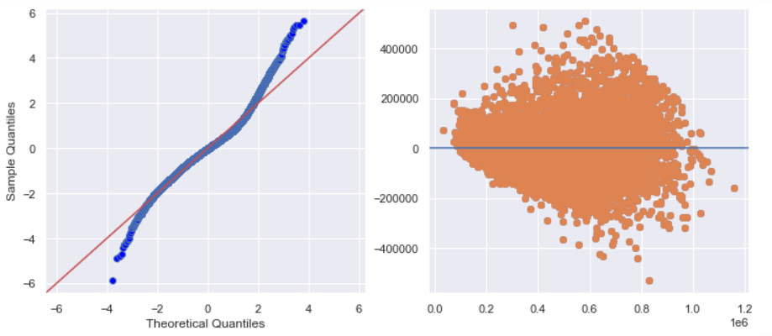
Regression Results
Model returned an Adjusted R-squared of 0.798
This means our model can explain 79.8% of the variance in price
QQ plot shows model is mostly normal with fatter tails
Homoscedasticity check is mostly cone-like
This indicates that our model is unbiased

Slide 5
Findings
Primary Price Drivers
Living Square Feet - $159 / sqft
Zip Codes - top 5 add $473-628k
Waterfront - $338k
Lot Square Feet - $3.45 / sqft
Basement - $23,634 penalty
Renovated - 42,260 bonus
Condition – between $0 and $174k
Less Significant Features
# Floors – penalty or bonus vary
Age - $168 penalty per year

Slide 6
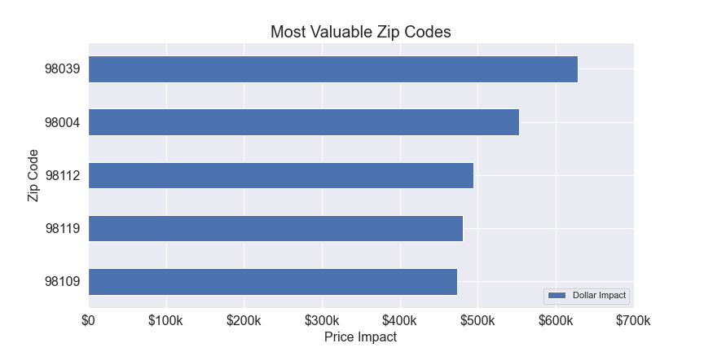
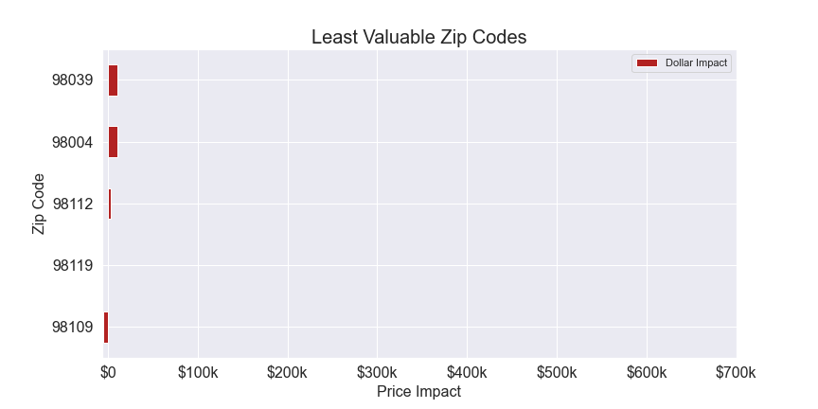
Zip Codes Most / Least Valuable
Top 5 Zip Codes
Add $473-628k to value
Located in metro area (Seattle, Bellevue, Mercer Island)
Closer to water
Bottom 5 Zip Codes
Range from $5k penalty to $10k bonus
Located in southern King County, Kent area
Landlocked

Slide 7
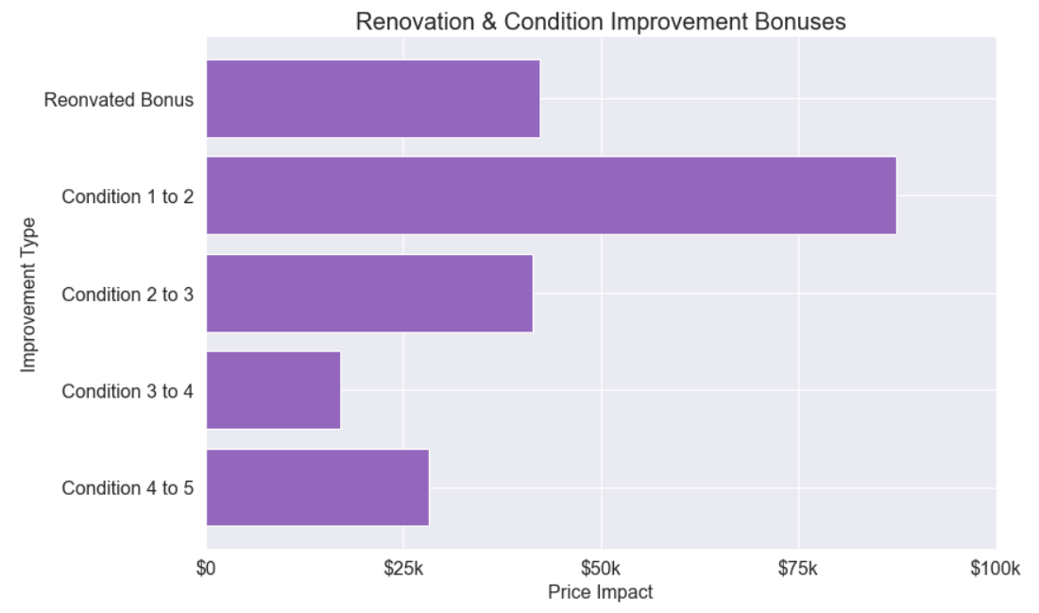
Recommendation: Renovate and Improve / Maintain Condition
Renovating to improve condition will provide $42k bonus
If the renovation improves the condition, additional bonus will be applied
Condition 1 to 2: + $87,360
Condition 2 to 3: + $41,455
Condition 3 to 4: + $17,031
Condition 4 to 5: + $28,288
Invest in regular maintenance to avoid condition deterioration penalty

Slide 8
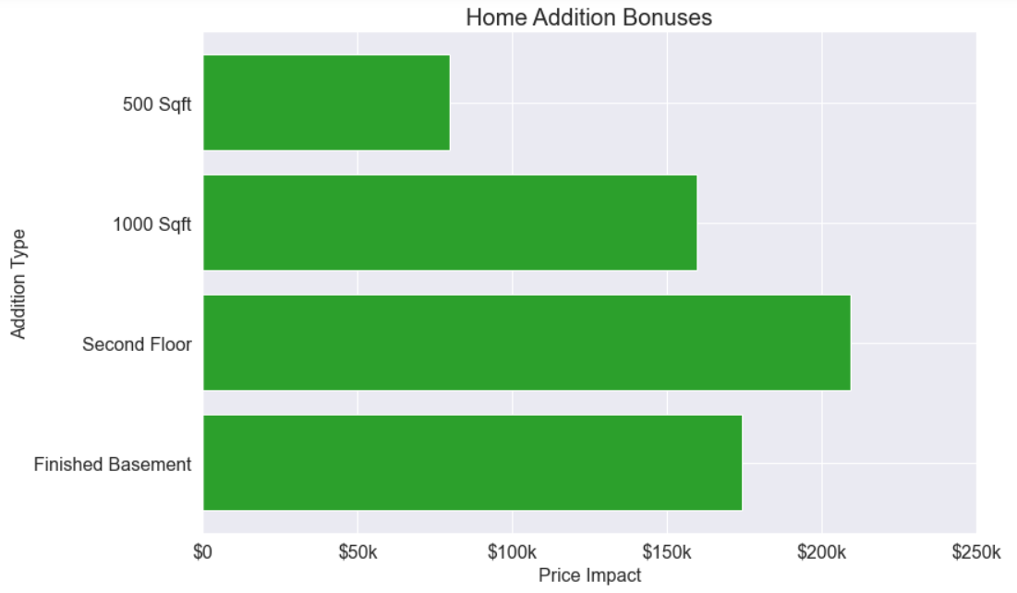
Recommendation: Add Living Square Footage through Construction
Each additional square foot will add $159 to the home value
500 sqft: $79,740
1000 sqft: $159,480
Building a second floor (approx. 1240 sqft)
1240 sqft: $197,755
2nd floor bonus: $11,448
Total: $209,204
Finishing a basement:
1240 sqft: $197,755
Basement penalty: (-) $23,634
Total: $174,121

Slide 9
Conclusions
Living Square Footage is most significant factor in home price
Zip Code is a primary price driver
Houses in city center and near water have higher value
Landlocked houses further from Seattle (especially in the Kent area) have less value
Recommendations:
Add living square footage via extension, finished basement, or second floor
Renovate
Improve / maintain condition

Slide 10
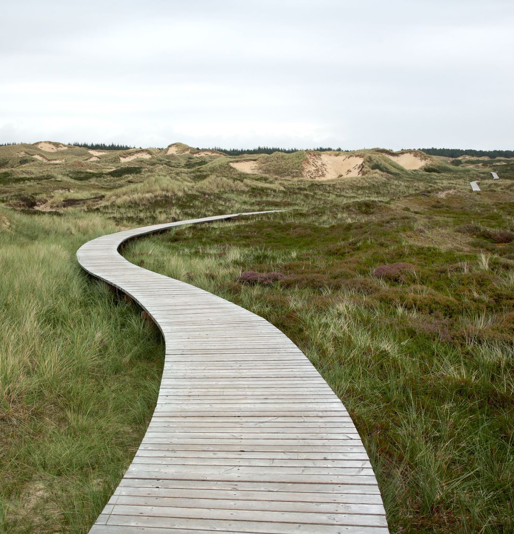
Next Steps
Implement Latitude, Longitude, Year Renovated, and Living & Lot Square Footage for closest 15 neighbors
Develop heatmap to refine geographic understanding
Normalize features to improve predictive quality
Create dynamic splitting functionality to run model on filtered datasets
Example: how specifically could the owner of a 2 story, 4 bedroom house in Bellevue improve their home value?

Slide 11
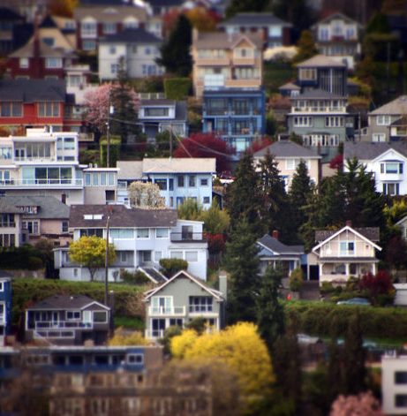
Thank you for your time!
Please feel free to ask any questions.

Slide 12
Appendix

Slide 13
Unused Data
Sale Date
# Bedrooms
# Bathrooms
View
Grade
Basement Square Footage
Non-Basement Square Footage
Year Renovated
Latitude
Longitude
Living Square Footage – 15 Nearest Neighbors
Lot Square Footage – 15 Nearest Neighbors

Slide 14
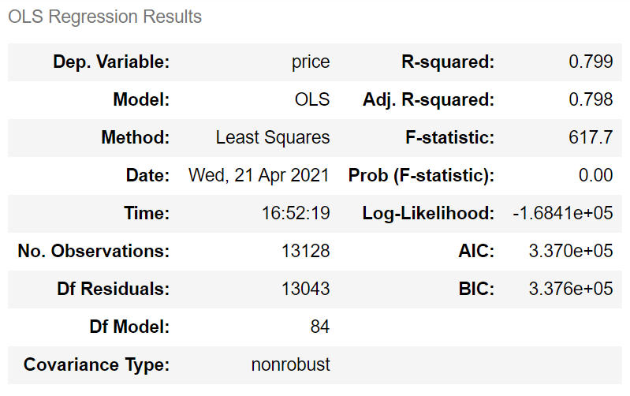
Regression Model

Slide 15
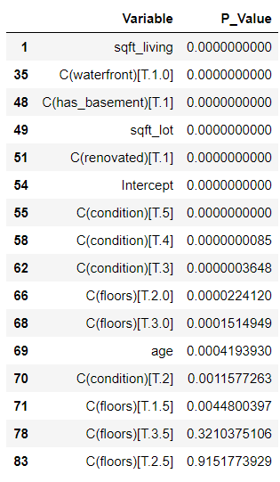
P-Value Rankings

